Slide 1
Topic 17 Threat Risk Modelling
ST251Z Ethical Hacking and Defences

Slide 2
Software Design
Security should be part of software development lifecycle
Security of software need to be considered in the design phase
Threat modelling – important tool

Slide 3
Threat Modelling Process
Assemble the threat modelling team
Decompose the application
Determine the threats to the system
Rank the threats by decreasing risk
Choose how to respond to the threats
Choose techniques to mitigate the threats
Choose technologies for the identified techniques

Slide 4
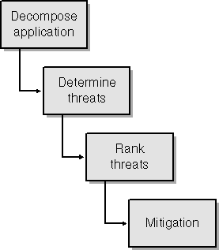
Threat Modelling Process
The entire process can be summarised as:

Slide 5
Assemble Threat Modelling Team
Gather at least 1 member from each development group
Eg. 1 representative from design, coding, testing and documentation team
Choose the person most “security-savvy”
If you have people outside your immediate team who are good with security, invite them

Slide 6
During Threat Modelling Meetings
Do not try to fix problems and supply solutions
The purpose of the meeting is to find threats, not fix them.
Identify the components of the application, how they interact and, eventually, find as many security threats as possible.
The design and code changes (and arguments) are made in later meetings.

Slide 7
Decompose Application
Break down application into smaller modules/functions
Understand each module. For example
how data enters the module
how the module validates and processes the data
where the data flows to
how the data is stored
Any fundamental decisions and assumptions made by the module

Slide 8
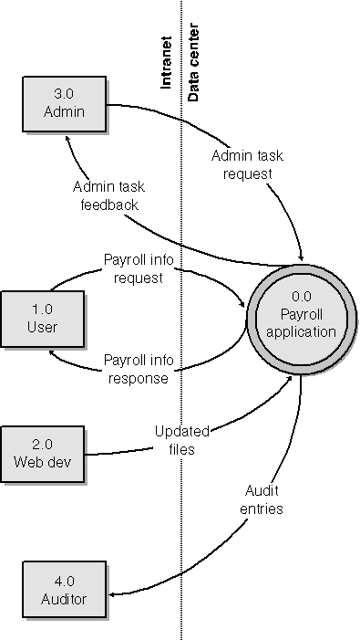
Decompose Application
Can use diagrams that can illustrate flow of data
Data Flow Diagrams (DFD)
Activity Diagrams
Example
Web-based Payroll Appln
Context Diagram

Slide 9
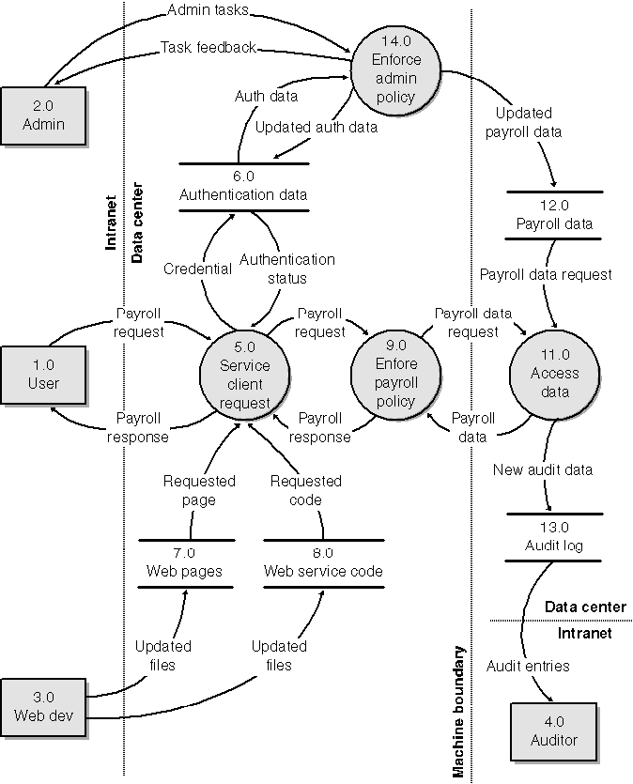
Decompose Application
Example
Level 1 diagram

Slide 10
Determine Threat
Take the identified components from the decomposition process and use them as the threat targets for the threat model.
The reason you analyze the application structure is not to determine how everything works, but rather to investigate the components, or assets, of the application and how data flows between the components.
Apply certain strategies to mitigate specific threat categories.

Slide 11
Categorize threats
Can use STRIDE to categorize threats
Spoofing Identity
Tampering with Data
Repudiation
Information Disclosure
Denial of Service
Elevation of Privilege
Some threats may belong to more than 1 category

Slide 12
STRIDE
Spoofing Identity
Spoofing threats allow an attacker to pose as another user or allow a rogue server to pose as a valid server.
Tampering with Data
Malicious modification of data
Repudiation
Users who deny performing an action without other parties having any way to prove otherwise
Example : User purchase an item and later denied having done so

Slide 13
STRIDE
Information Disclosure
Exposure of information to individuals who are not supposed to have access to it
Denial of Service
Deny service to valid users
Making a Web server temporarily unavailable
Elevation of Privilege
An unprivileged user gains privileged access and thereby has sufficient access to compromise or destroy the entire system

Slide 14
Sample Threats
A malicious user views or tampers with personal data travelling between the Web server and the client. (Tampering with data/Information disclosure)
A malicious user views or tampers with personal data travelling between the Web server and the database. (Tampering with data/Information disclosure)

Slide 15
Sample Threats (continued)
An attacker denies access to the database server computer by flooding it with packets (Denial of service)
A malicious user views the authentication packets travelling between the Web Server and the client and learns how to forge them so that he can pretend to be the user (Spoofing identity/Information disclosure/Elevation of privilege if user is administrator)

Slide 16
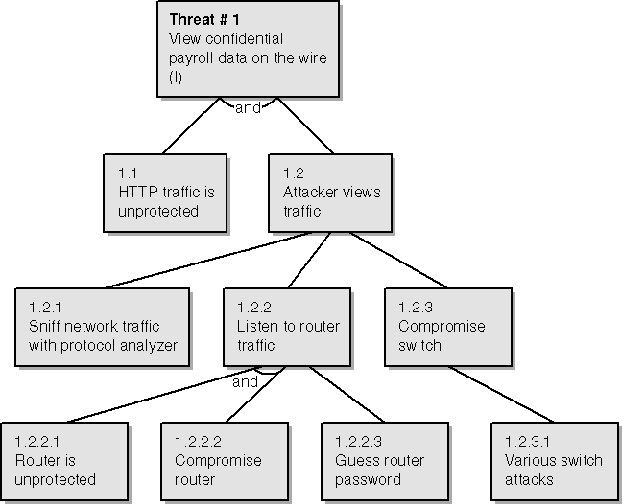
Threat Tree / Threat Graph
Diagram showing how a threat may be realised

Slide 17
Improved Threat Tree
Dotted lines to show least likely attack path
Circles below least likely attack path with text indicating why the attack is mitigated

Slide 18
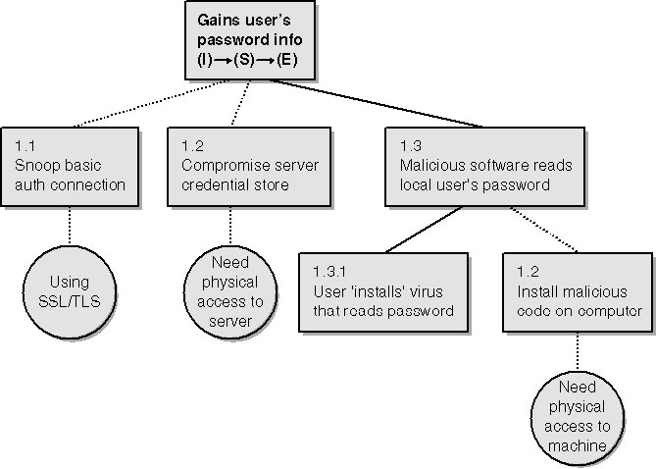
Improved Threat Tree

Slide 19
Rank Threats
Need to prioritize threats
Use risk analysis method
Risk = Criticality * likelihood of occurance
Can use DREAD metrics

Slide 20
DREAD
Damage Potential
Reproducibility
Exploitability
Affected Users
Discoverability

Slide 21
Calculating DREAD
Each metric criteria carries a value from 0 to 10
0 being minimal possibility
10 being the worst
For each threat,
Rank them in each metric criteria
Add all the values up
Divide by 5
Rank threats according to this mean value

Slide 22
DREAD
Damage Potential
If a threat exploit occurs, how much damage will be caused?
0 = Nothing
5 = Individual user data is compromised or affected.
10 = Complete system or data destruction
Reproducibility
How easy is it to reproduce the threat exploit?
0 = Very hard or impossible, even for administrators of the application.
5 = One or two steps required, may need to be an authorized user.
10 = Just a web browser and the address bar is sufficient, without authentication.

Slide 23
DREAD
Exploitability
What is needed to exploit this threat?
0 = Advanced programming and networking knowledge, with custom or advanced attack tools.
5 = Malware exists on the Internet, or an exploit is easily performed, using available attack tools.
10 = Just a web browser

Slide 24
DREAD
Affected Users
How many users will be affected?
0 = None
5 = Some users, but not all
10 = All users
Discoverability
How easy is it to discover this threat?
0 = Very hard to impossible; requires source code or administrative access.
5 = Can figure it out by guessing or by monitoring network traces.
9 = Details of faults like this are already in the public domain and can be easily discovered using a search engine.
10 = The information is visible in the web browser address bar or in a form.

Slide 25
Example of Calculating Risk
Threat #1: Malicious user views confidential on-the-wire payroll data.
Damage potential (8): Reading others' private payroll data is very serious.
Reproducibility (10): It is 100 percent reproducible.
Exploitability (7): Attacker must be on subnet or have compromised a router. Affected users (10): Everyone, including Jim the CEO, is affected by this! Discoverability (10): Let's just assume it'll be found out!
Risk(DREAD): (8+10+7+10+10) / 5 = 9

Slide 26
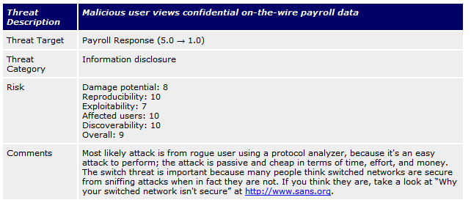
Calculating Threat Risk
Threat #1

Slide 27
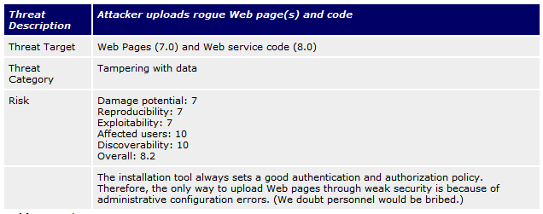
Calculating Threat Risk
Threat #2

Slide 28
Mitigating Risk
2-step process.
Step 1: determine which techniques can help
Step 2: choose the appropriate technologies

Slide 29
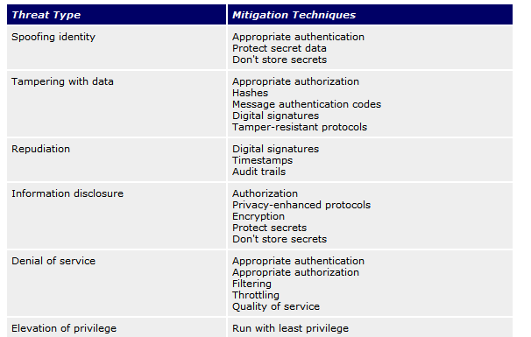
Mitigating Techniques

Slide 30
MITRE ATT&CK Framework
Knowledge base of cyber attack tactics and techniques
Data gathered from real world observations
Community-driven
Organisations can use the framework to
Identify gaps in defences
Improve detection of attacks
Conduct red-teaming exercises
https://attack.mitre.org

Slide 31
MITRE ATT&CK Matrices
Categories of matrices
Enterprise
Tactics and Techniques used to compromise general computer/network systems
Mobile
Tactics and Techniques used to gain access to mobile devices
ICS
Tactics and Techniques used to gain access to Industrial Control Systems (ICS)

Slide 32
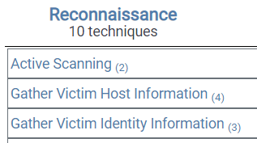
MITRE ATT&CK Tactics and Techniques
Techniques used by cyber attackers are grouped into categories called tactics
Tactics are why – why are the attackers carrying out the techniques, what are their objectives?
Techniques are how the attackers try to achieve them
Tactics
Techniques
(Extract of Enterprise Matrix – Reconnaissance tactic)

Slide 33
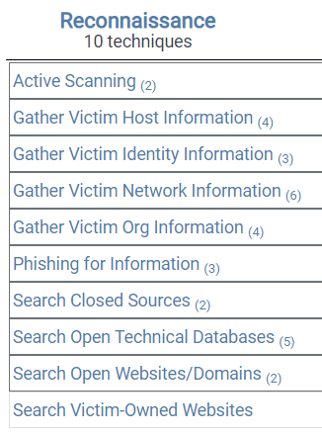
Tactics and Techniques
For example, to do Reconnaissance (Information Gathering or Footprinting) on a system, attackers may try the techniques listed under the tactic “Reconnaissance”

Slide 34
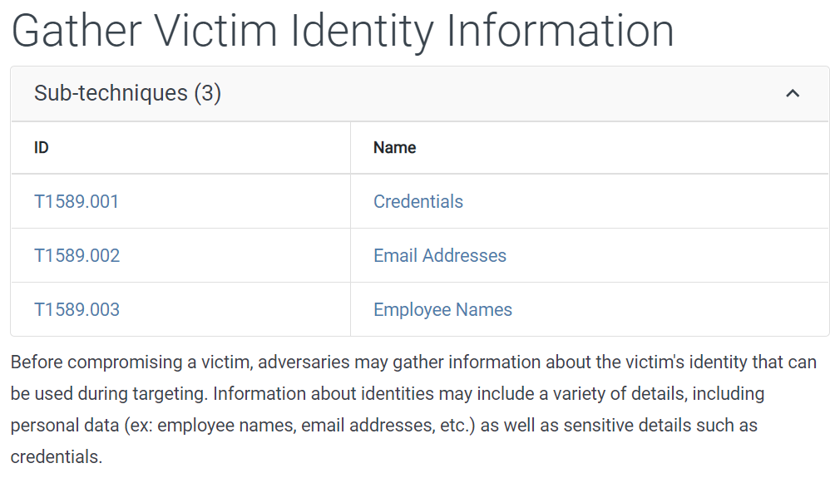
Tactics and Techniques
Some techniques may contain sub-techniques

Slide 35
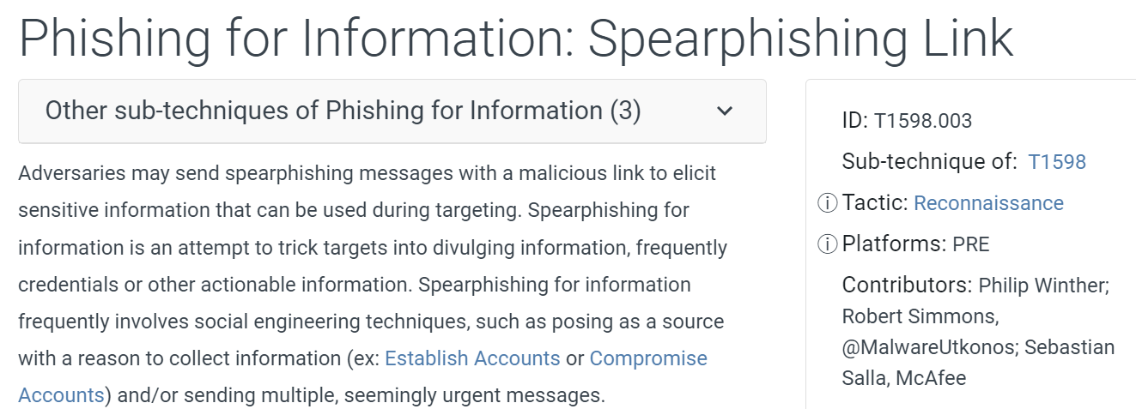
Tactics and Techniques
For each technique/sub-technique, there is a description, how to mitigate, how to detect it

Slide 36
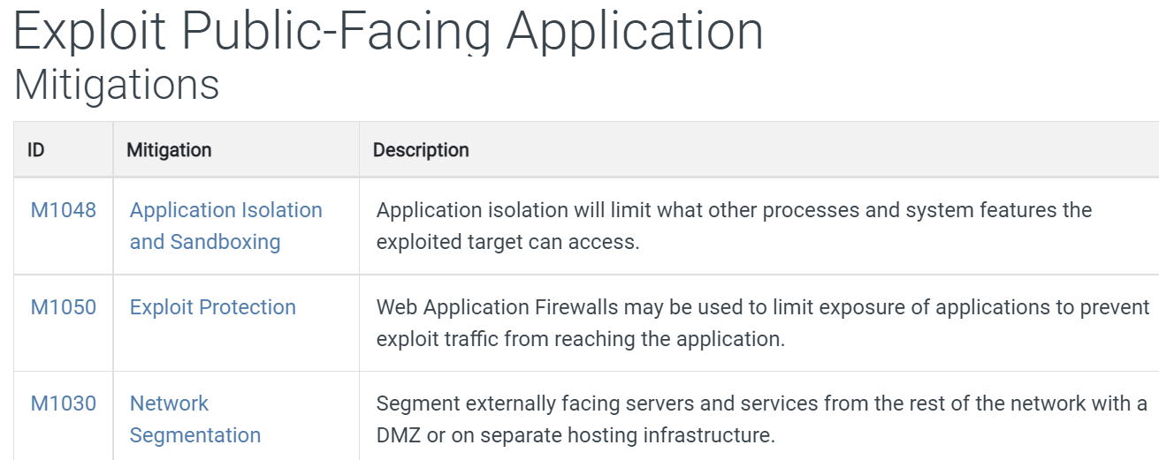
Tactics and Techniques
Examples of Mitigations

Slide 37
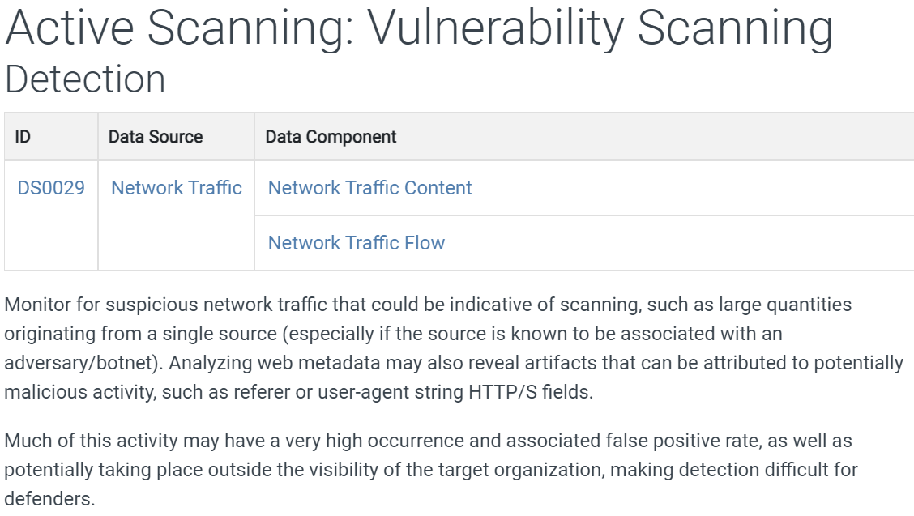
Tactics and Techniques
Examples of Detection

Slide 38
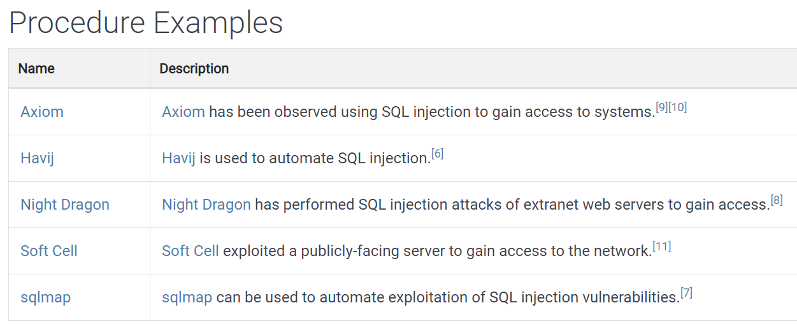
Tactics and Techniques
For each technique/sub-technique, it also has Procedure Examples (observed to be used before)

Slide 39
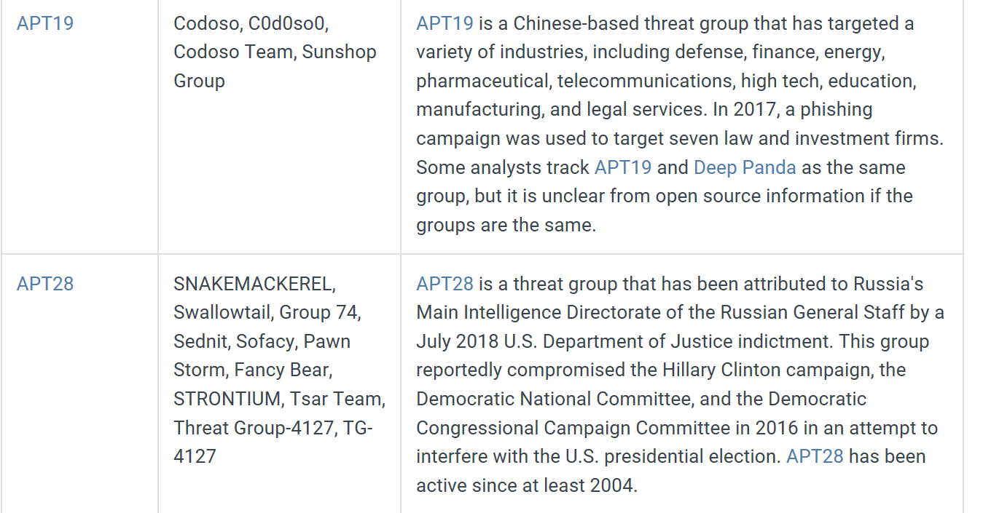
MITRE ATT&CK Groups
MITRE ATT&CK also provides information on groups of related cyber attacks based on observation

Slide 40
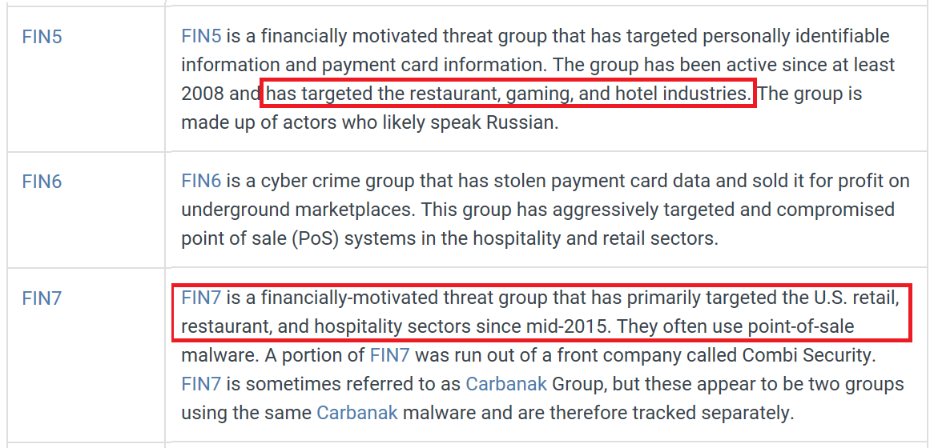
MITRE ATT&CK Groups
Organisations can check which groups of cyber attacks may be targeting their industry sector, and check their defences against these groups’ usual attack techniques

Slide 41
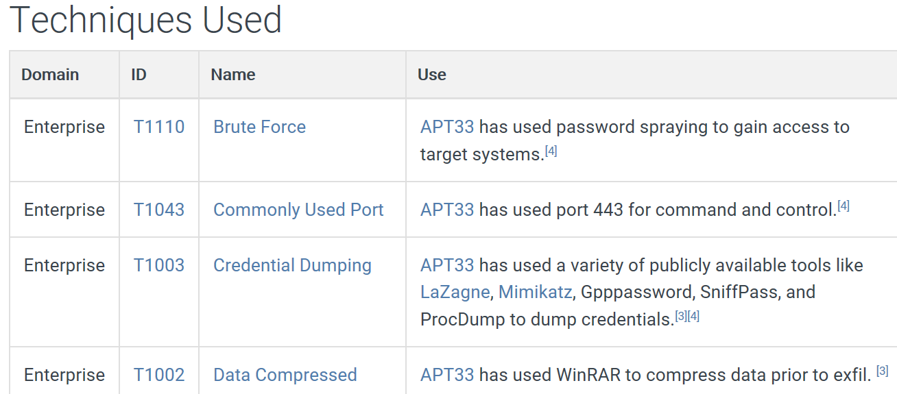
MITRE ATT&CK Groups
Group information includes suspected victims and techniques used

Slide 42
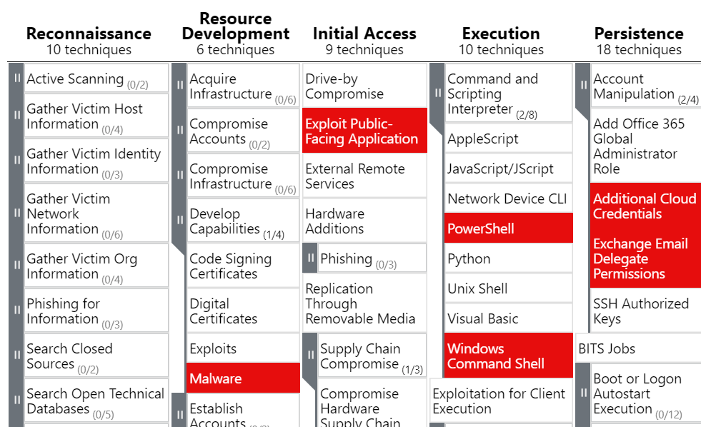
MITRE ATT&CK Groups
Techniques used by the group UNC2452 (Dark Halo) behind SolarWinds breach
www.picussecurity.com/resource/blog/ttps-used-in-the-solarwinds-breach
https://mitre-attack.github.io/attack-navigator/#layerURL=https://raw.githubusercontent.com/center-for-threat-informed-defense/public-resources/master/solorigate/UNC2452.json

Slide 43
MITRE ATT&CK Framework
Community-driven
Sharing of Threat Intelligence
Helps organisations to understand real-world attacks and assess their defences against them
Red teams can emulate techniques to test the organisation’s defences

Slide 44
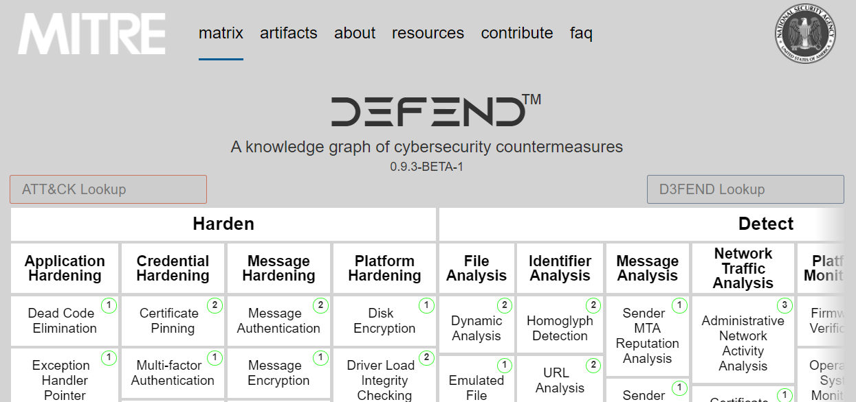
MITRE D3FEND
While Mitre ATT&CK focuses on offensive cybersecurity, Mitre D3FEND focuses on cyber defenses.
Discusses defensive best practices
https://d3fend.mitre.org

